Slide 1
Lab 1

Slide 2
Agenda
Go through Lab Activity (and Assignment 2)
Presentation on using ACM library
The team charter that each group needs to read, 'sign' and submit by next Tuesday night (due Tuesday Oct. 27 at 11:00pm – submit on Brightspace)
Announce the groups
Divide up the topics
[in groups work on Lab1]

Slide 3
Lab 1
Due end of lab today (11:00 pm on Brightspace)
After I do the presentation on "Finding ACM Papers" – in your group, everyone finds one relevant ACM paper for your topic [online applications for classes, meetings, etc.]
Quickly read/skim the papers and as a group and come up with 3 or 4 themes that are common between the papers (a theme should cover 3 of the 5 papers OR 2 of the 4 papers). For each theme – write 2-3 sentences (can be in point form) to describe the theme (also make sure you include the papers that attribute to the theme). All papers must be included in at least one theme.
Assign one member to do an individual summary of the paper (Assignment 2)
NOTE: Each research paper should be 4-8 pages.

Slide 4
Assignment 2 (use Lab 1 to help)
After you have decided which team member will summarize each paper, use the template on Brightspace to help you disseminate the paper to create a useful summary.
Assignment 2 is due on Friday Oct, 7 at 11:00p.m.
Your group will use these summaries in the first Milestone of the project.
Note: Bonnie will reschedule Assignment 1 – it is not necessary for this assignment

Slide 5
The Team Charter
Each group needs to read and submit the team charter (with relevant parts filled in e.g., team names)
The charter outlines the responsibility of the team and provides information for the project (e.g., team communication, sharing of documents, team behavior, break down of work).
Please read over it and submit it with everyone's name added to the end of the document by next Tuesday at 11:00pm. If you have questions, Bonnie will have time in next Monday's class.

Slide 6
How to find relevant papers on the ACM
You will select relevant research papers using the ACM library.
We will go through how to use the ACM library and find relevant papers.

Slide 7
Finding "Good" Papers
For your group project, you will need to find relevant research papers on your topic
The ACM or other recognized organizations (e.g., the IEEE) have databases of conference proceedings papers and journal papers that have been peer reviewed.
"Scholarly peer review (also known as refereeing) is the process of subjecting an author's scholarly work, research, or ideas to the scrutiny of others who are experts in the same field, before a paper describing this work is published in a journal, conference proceedings or as a book. The peer review helps the publisher (that is, the editor-in-chief, the editorial board or the program committee) decide whether the work should be accepted, considered acceptable with revisions, or rejected."
From: https://en.wikipedia.org/wiki/Peer_review

Slide 8
ACM Library
For our project, we will focus on the ACM to find scholarly papers (peer-reviewed papers) related to your topics

Slide 9
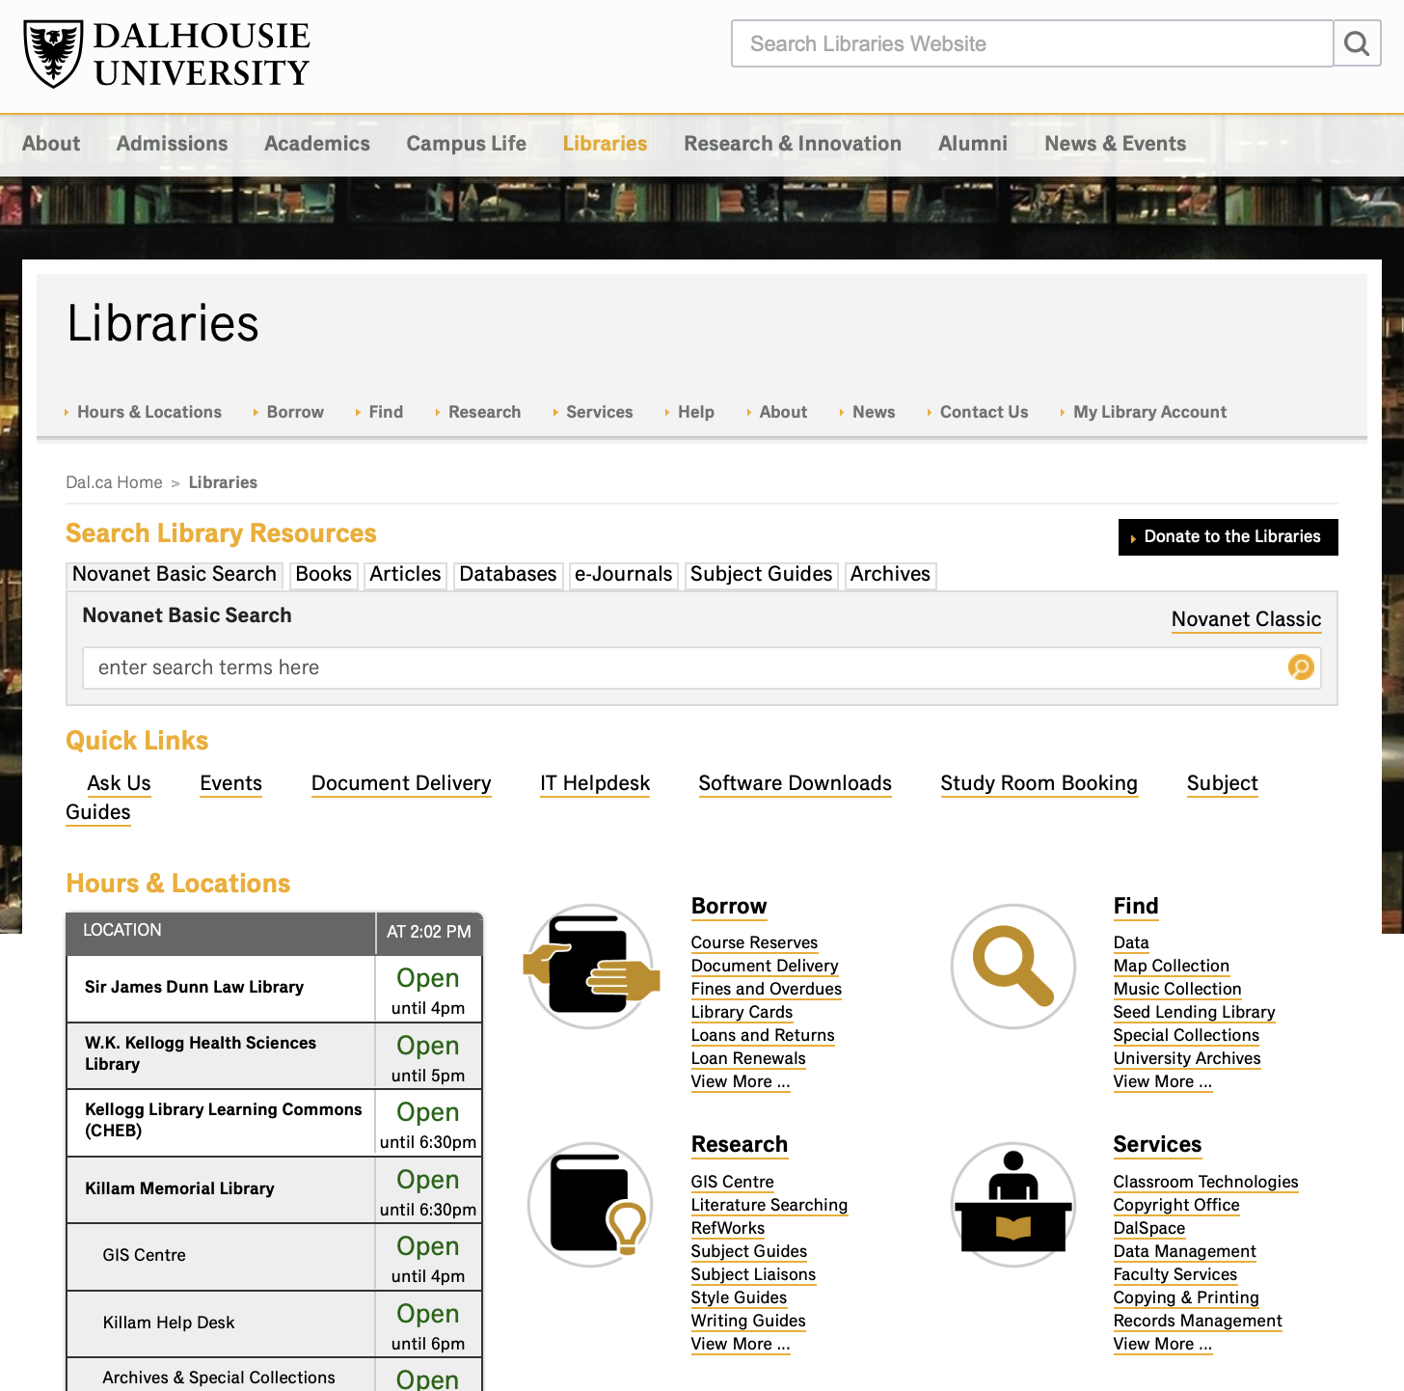
How to find papers…
Go to dal libraries: https://libraries.dal.ca

Slide 10
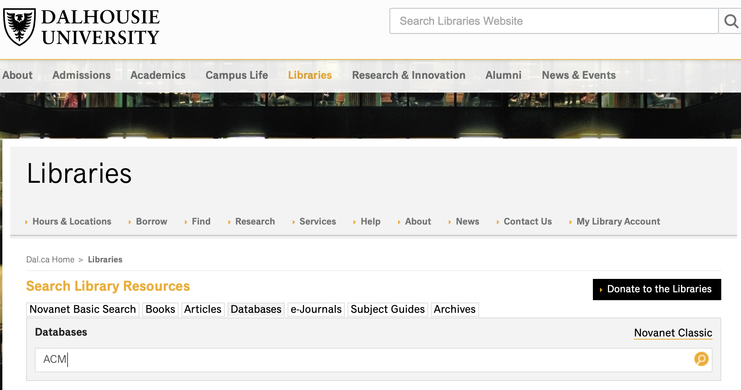
How to find papers…
Select Database and type ACM

Slide 11
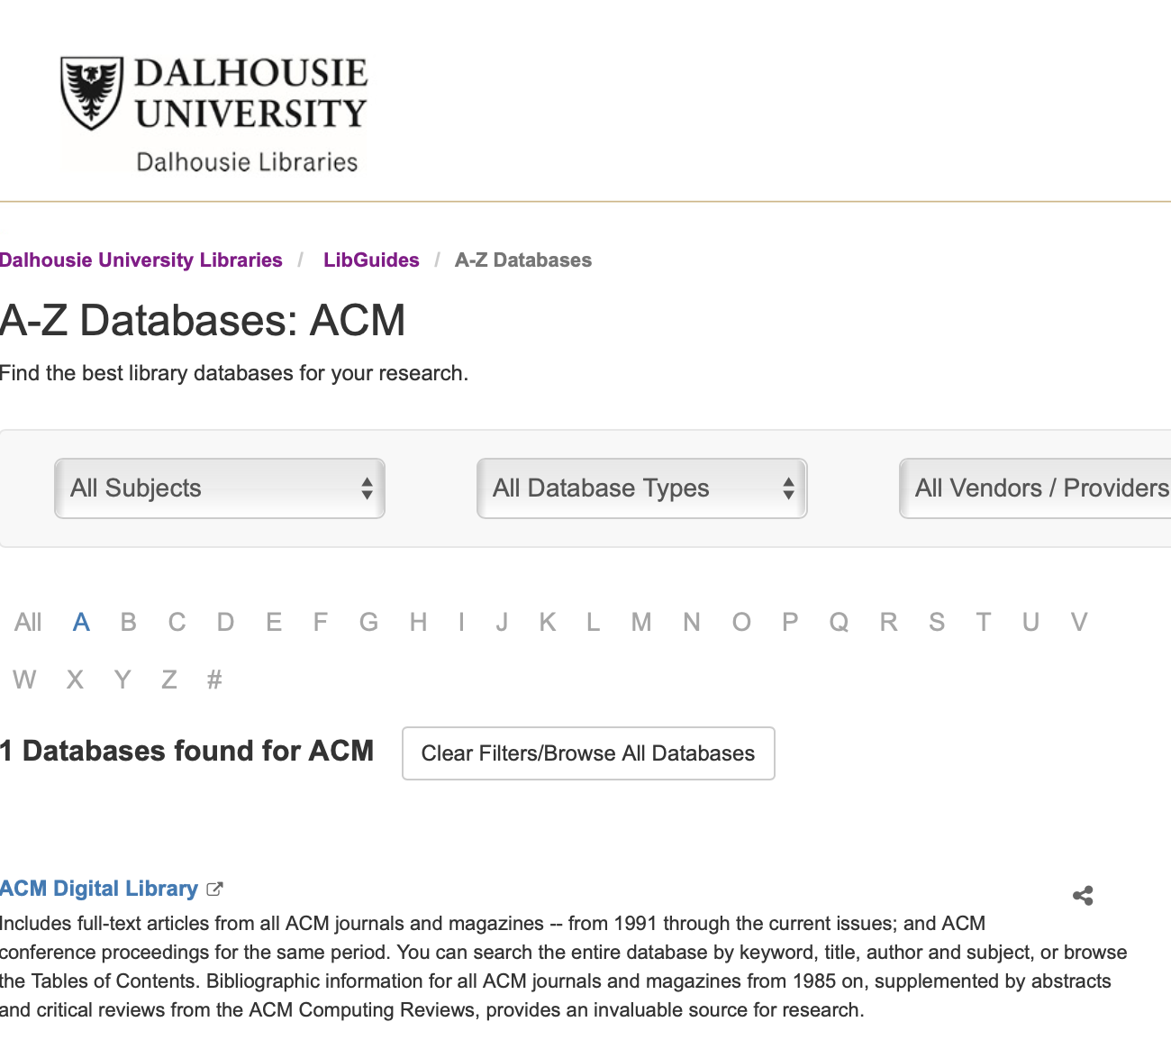
How to find papers…
Select ACM Digital Library

Slide 12
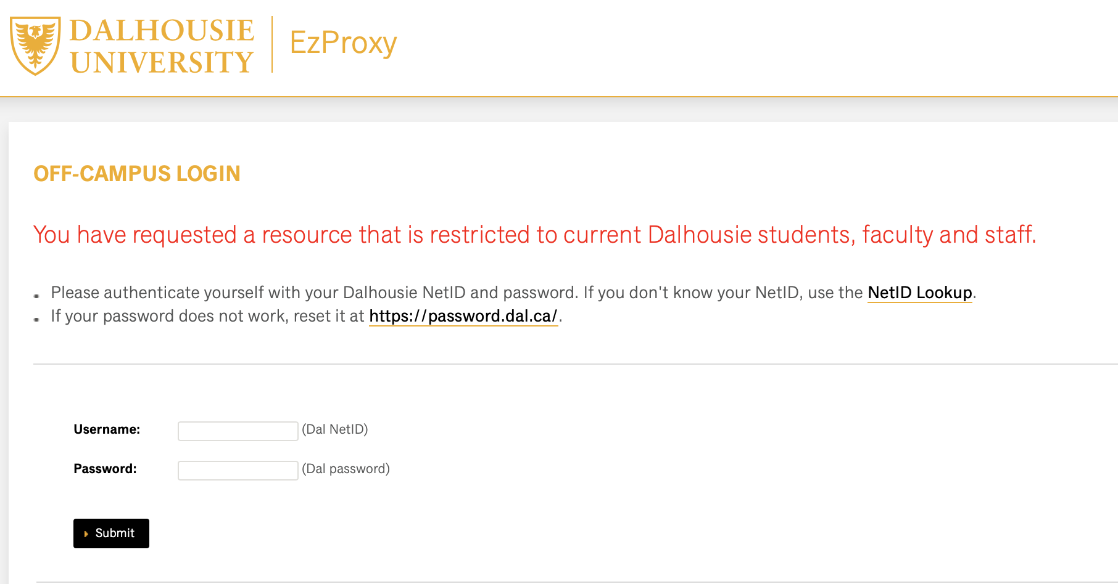
How to find papers…
If you are off campus, you'll need to sign in using your Dal username (email) and password. If you are accessing the database while on campus you won't need to do this step.

Slide 13
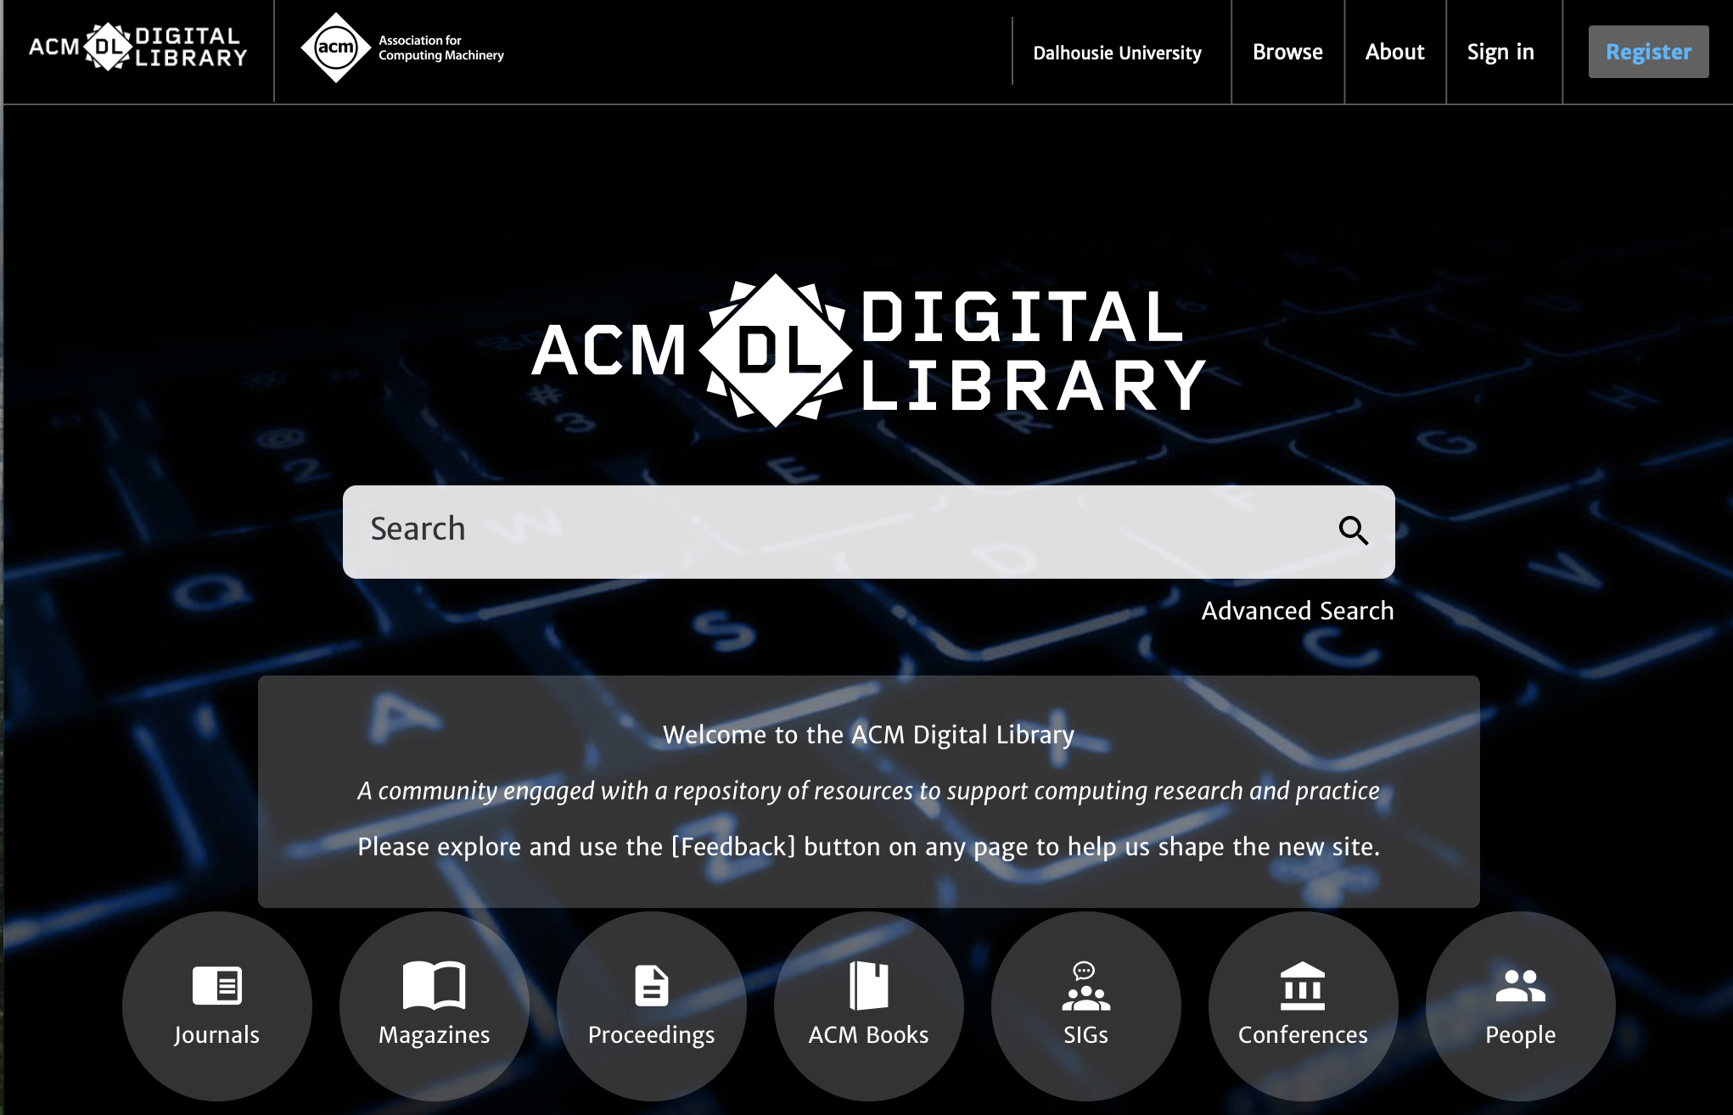
How to find papers…
You will be brought to the ACM's main page. You can start by just typing in keywords on your topic (you can use journal articles and conference proceedings so you can just search)

Slide 14
Let's try it out…
Let's say the topic was helping users navigate maps on small devices while walking (e.g., Smartphones).
First, we need to see what has already been studied and/or developed.
Come up with some terms/phrases as sometimes you'll get different results
Mobile maps
Navigating maps on Smartphones
Using maps while walking
Etc.

Slide 15
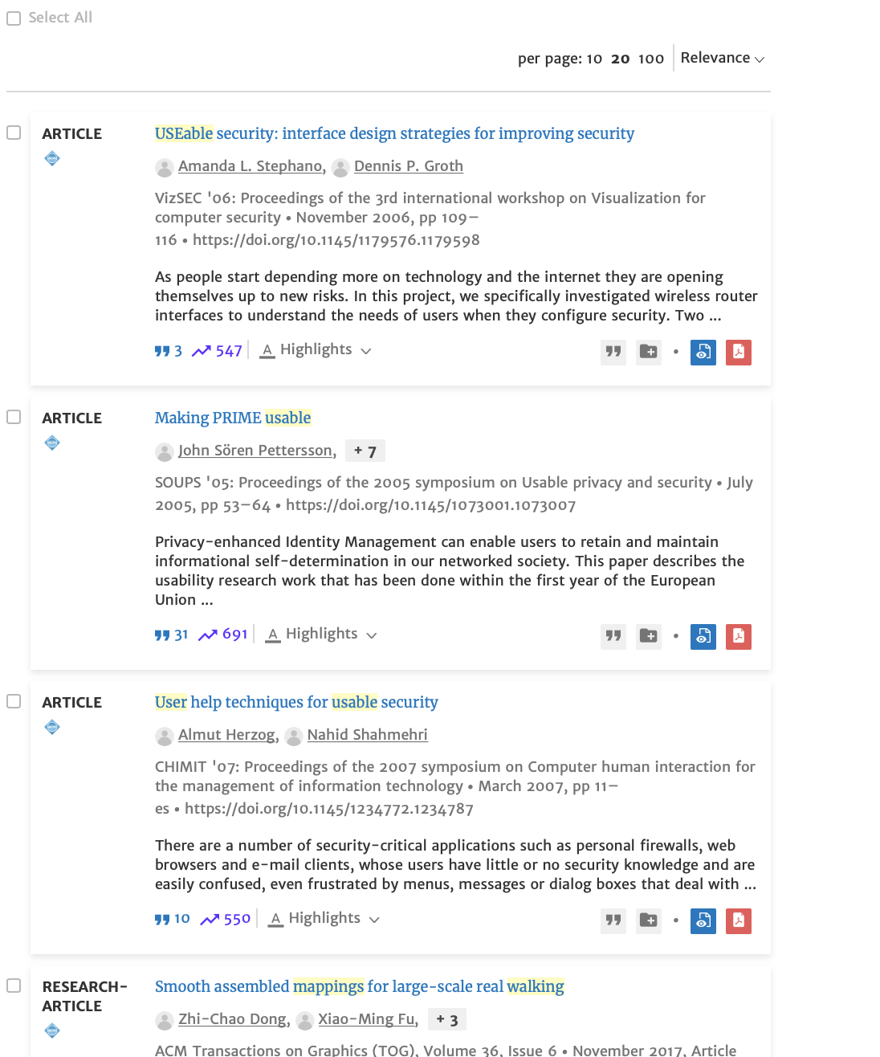
Searched for:
Using maps while walking
..but the results don't seem to match what I wanted. So refine your search…

Slide 16
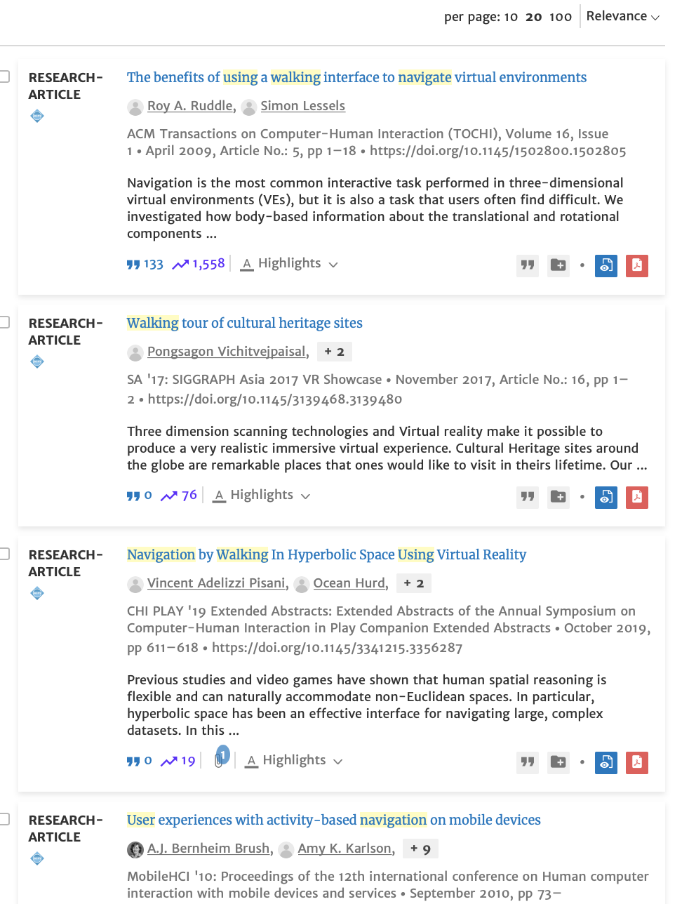
Updated search to:
how users navigate while walking
Now at least it looks like some papers are relevant…
So let's see what this paper is about…

Slide 17
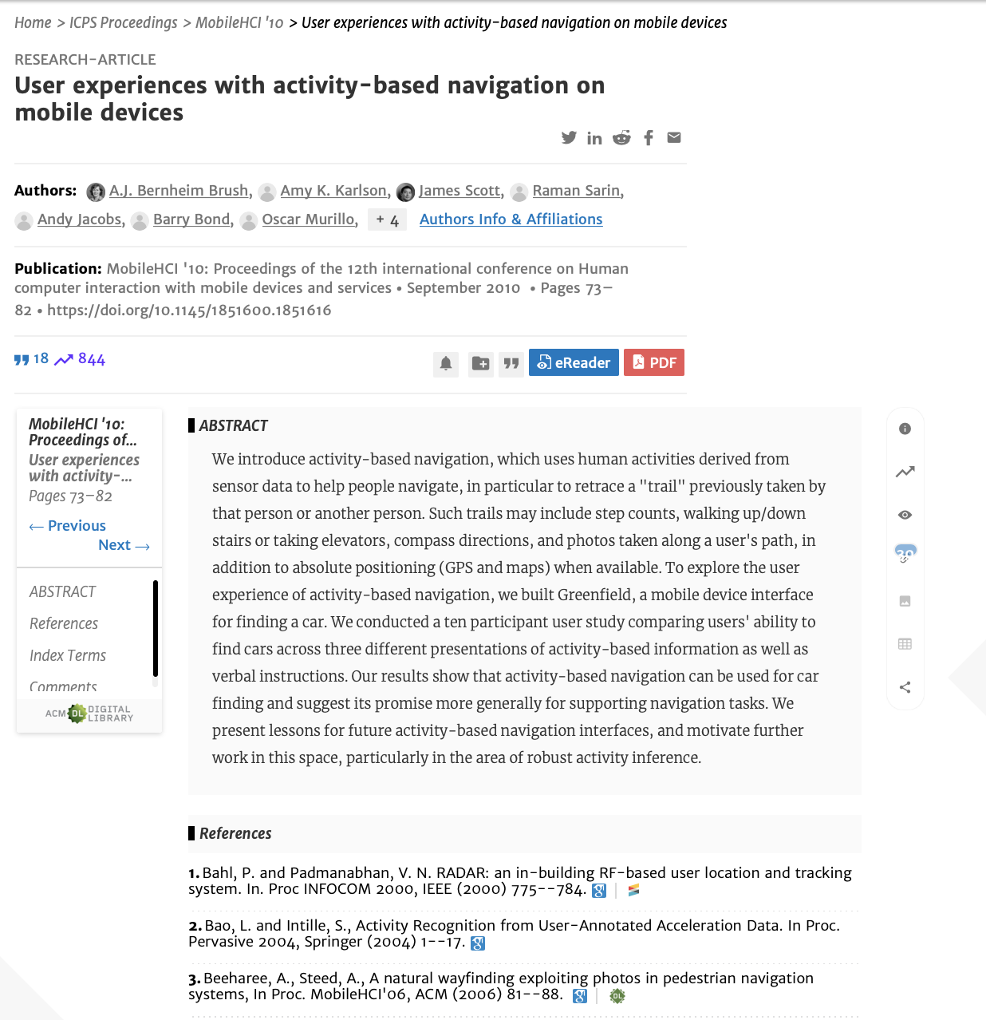
From the main page, we can get information about this paper to help determine if we want to read it.
It's a conference paper.
It was published in 2010.
It is 9 pages.
Then read the abstract. Based on the abstract it doesn't seem really relevant and it is 10 years old… (NOTE: sometimes an older paper is okay especially if it has been influential to the field).

Slide 18
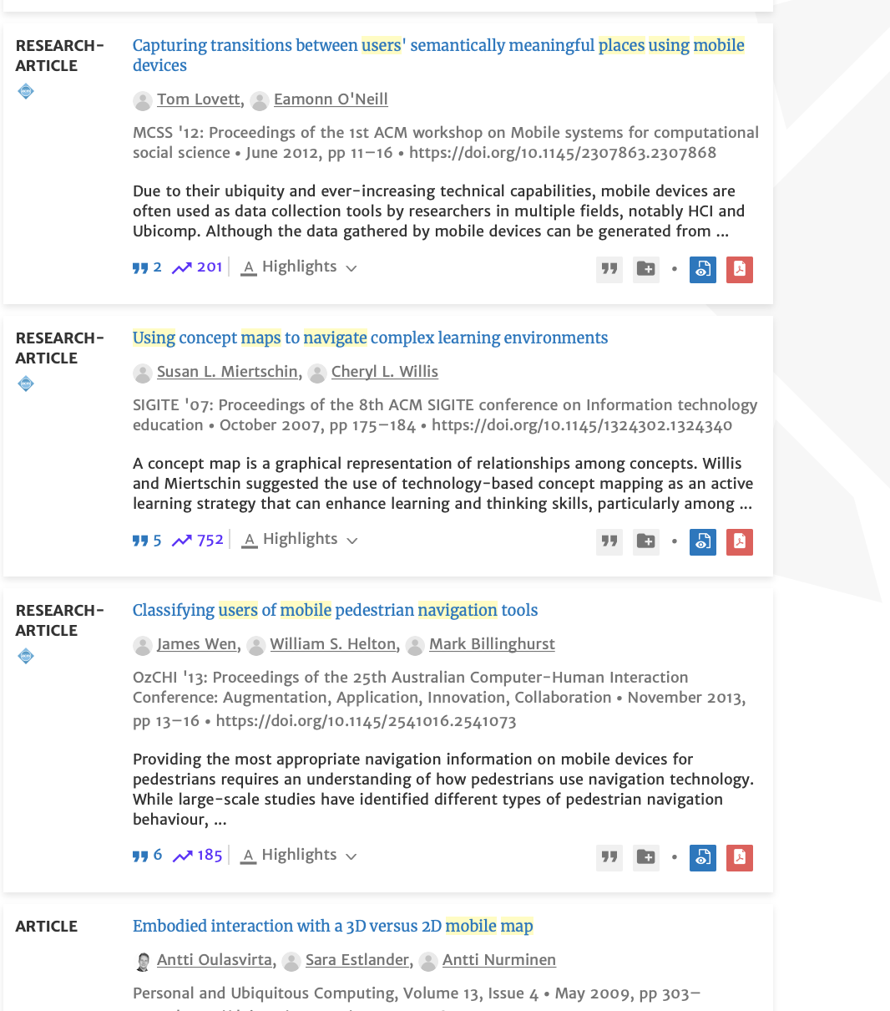
New Search:
how users navigate new places with mobile maps
New list… This one looks interesting.

Slide 19
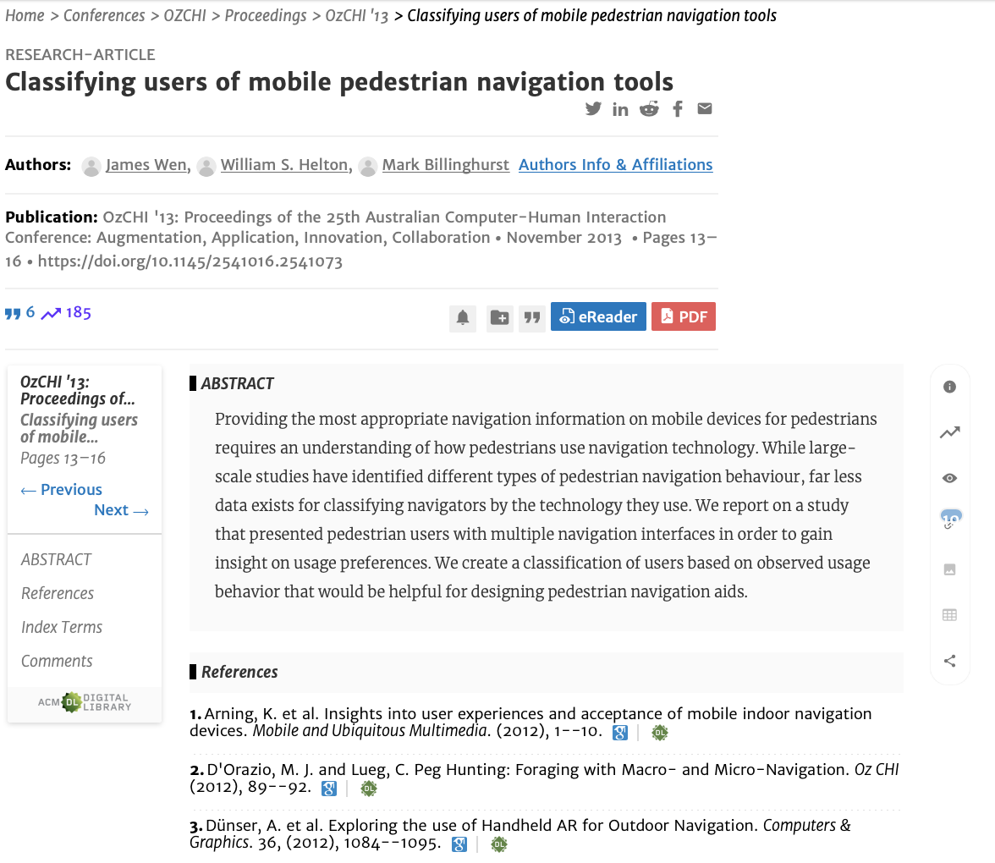
From the abstract, this sounds interesting and relevant.
Take a look at the actual article.

Slide 20
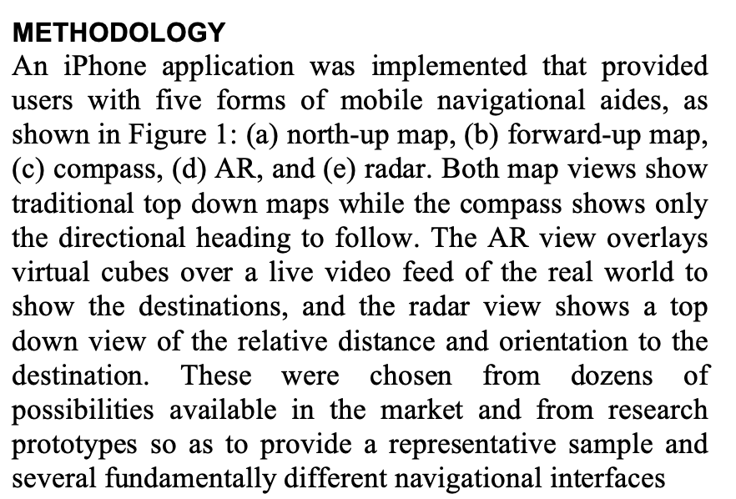
When looking at the paper, notice that it clearly describes what it is going to do…
This is a direct quote from to show how to read a paper:
James Wen, William S. Helton, and Mark Billinghurst. 2013. Classifying users of mobile pedestrian navigation tools. In Proceedings of the 25th Australian Computer-Human Interaction Conference: Augmentation, Application, Innovation, Collaboration (OzCHI ’13). Association for Computing Machinery, New York, NY, USA, 13–16. DOI:https://doi.org/10.1145/2541016.2541073
Never cut and paste into a document to be handed in!

Slide 21
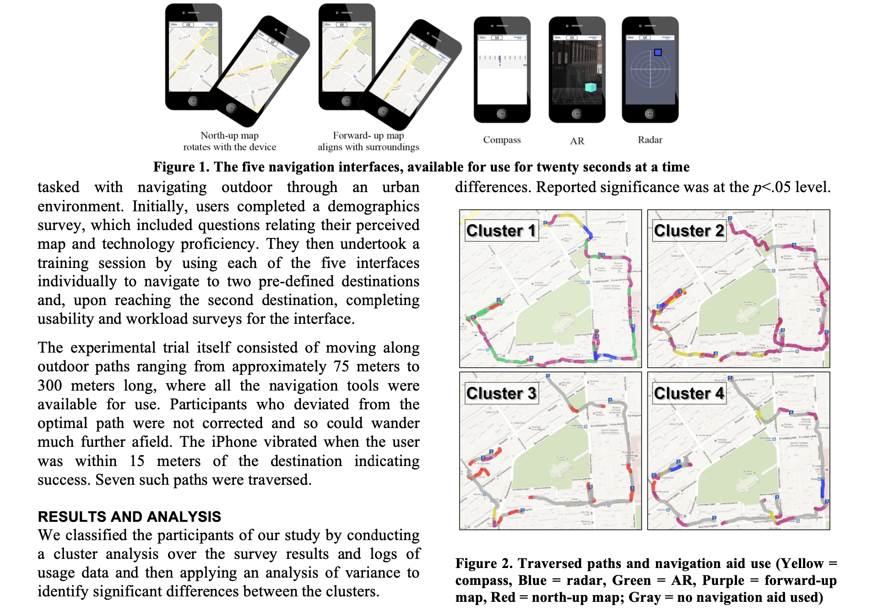
It has relevant images, and describes the study process well
This is a direct quote from to show how to read a paper:
James Wen, William S. Helton, and Mark Billinghurst. 2013. Classifying users of mobile pedestrian navigation tools. In Proceedings of the 25th Australian Computer-Human Interaction Conference: Augmentation, Application, Innovation, Collaboration (OzCHI ’13). Association for Computing Machinery, New York, NY, USA, 13–16. DOI:https://doi.org/10.1145/2541016.2541073
Never cut and paste into a document to be handed in!

Slide 22
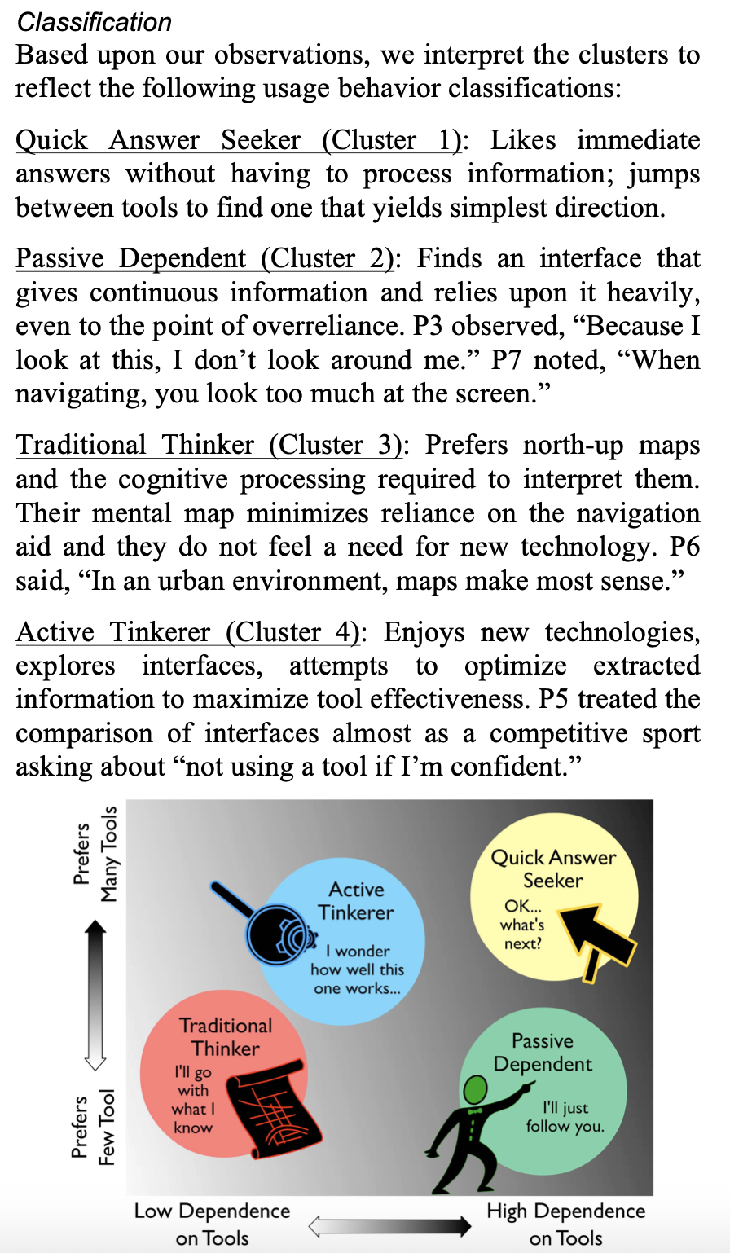
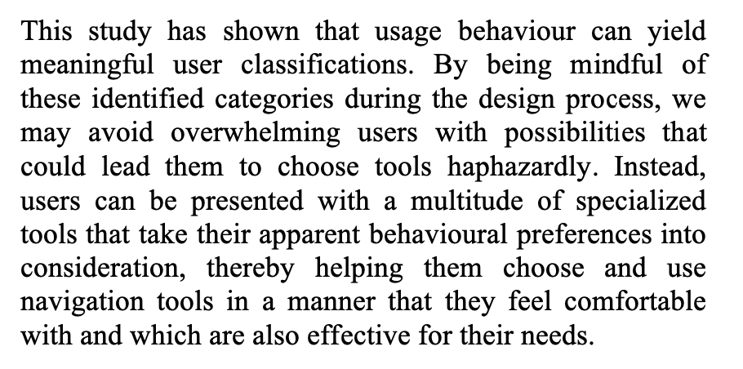
In the results, it describes four user classifications that could be beneficial to future development of apps.
This is a direct quote from to show how to read a paper:
James Wen, William S. Helton, and Mark Billinghurst. 2013. Classifying users of mobile pedestrian navigation tools. In Proceedings of the 25th Australian Computer-Human Interaction Conference: Augmentation, Application, Innovation, Collaboration (OzCHI ’13). Association for Computing Machinery, New York, NY, USA, 13–16. DOI:https://doi.org/10.1145/2541016.2541073
Never cut and paste into a document to be handed in!

Slide 23
How to find papers…
You may have to do several searches refining your terms to find appropriate and relevant results
You should start by examining the list of papers from the search results
For titles that seem relevant, you can open the main page to find out more info and read the abstract
Then if it seems alright, look at the actual paper. Look to see if it seems relevant (some papers will, and others won't)

Slide 24
How to find papers…
If you find a paper that seems relevant, that you think you will use, you can also look at that paper's references to help you find other papers and to see if other researchers cited this paper.
Sometimes, this will also help you find relevant papers.

Slide 25
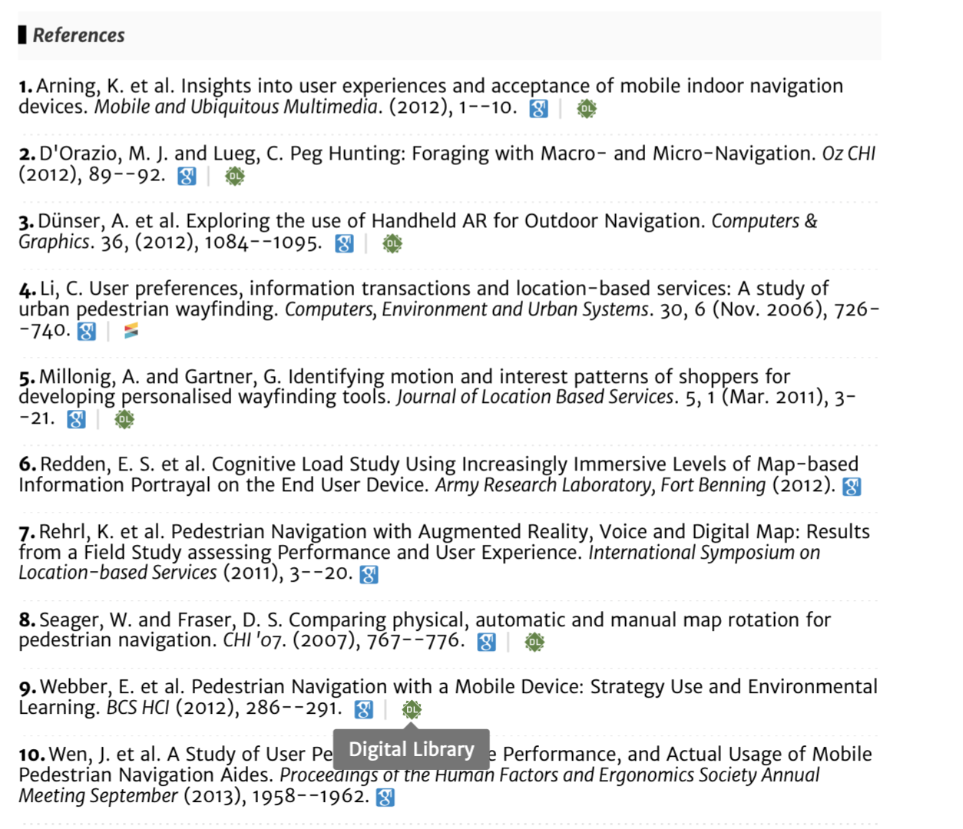
Looking at the references, this paper looks interesting…

Slide 26
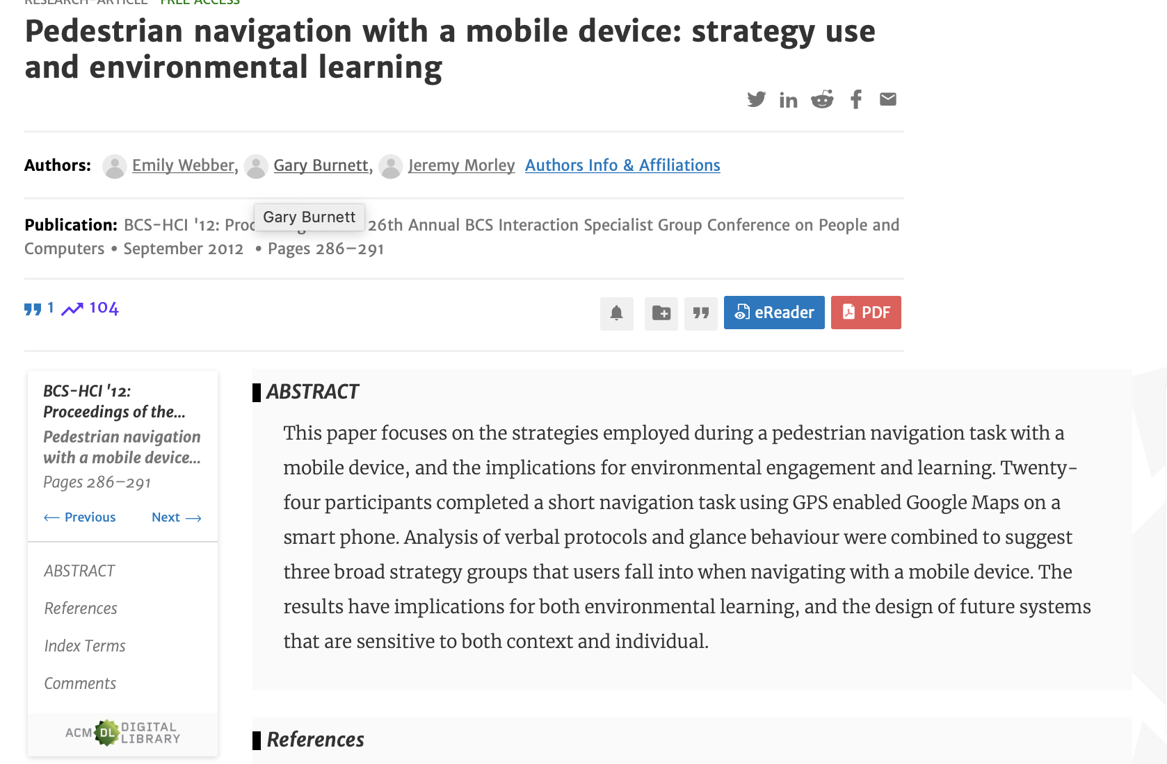
From the abstract this seems interesting. Note the date though, it's 10 years old, so it would have to be relevant to systems today (would figure out after reading).

Slide 27
How to find papers…
If you find a paper that seems relevant, you can also see who has cited it in future work. You can check that as well on the ACM

Slide 28
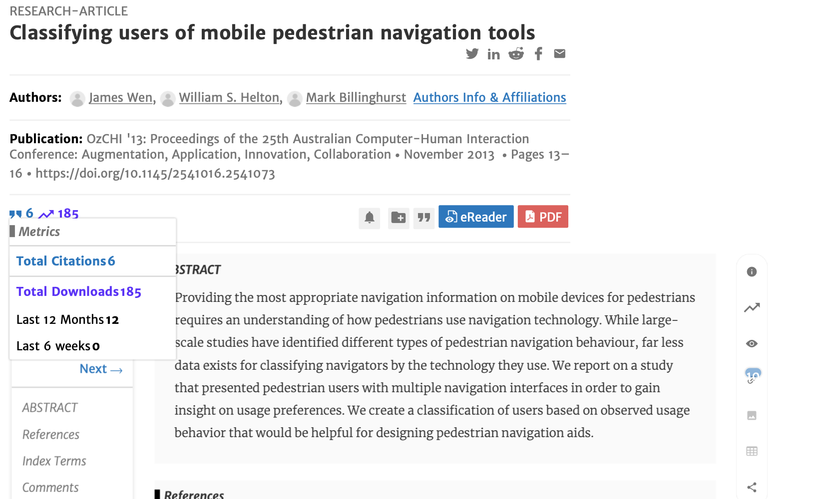
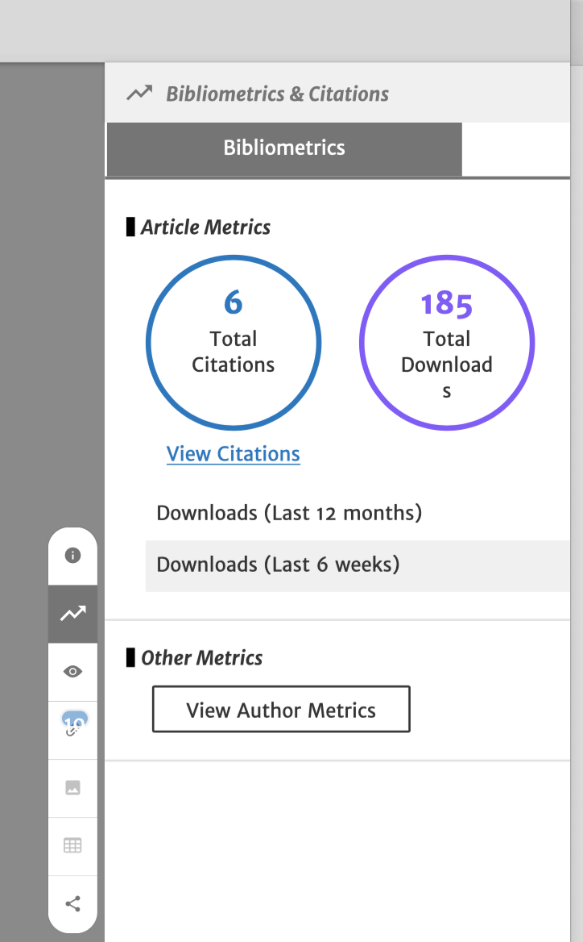
You can also check if the paper has been cited by other authors (often good papers have a high citation count). In this case, 6 papers have cited this work. You can click "View Citations" to see all the papers.

Slide 29
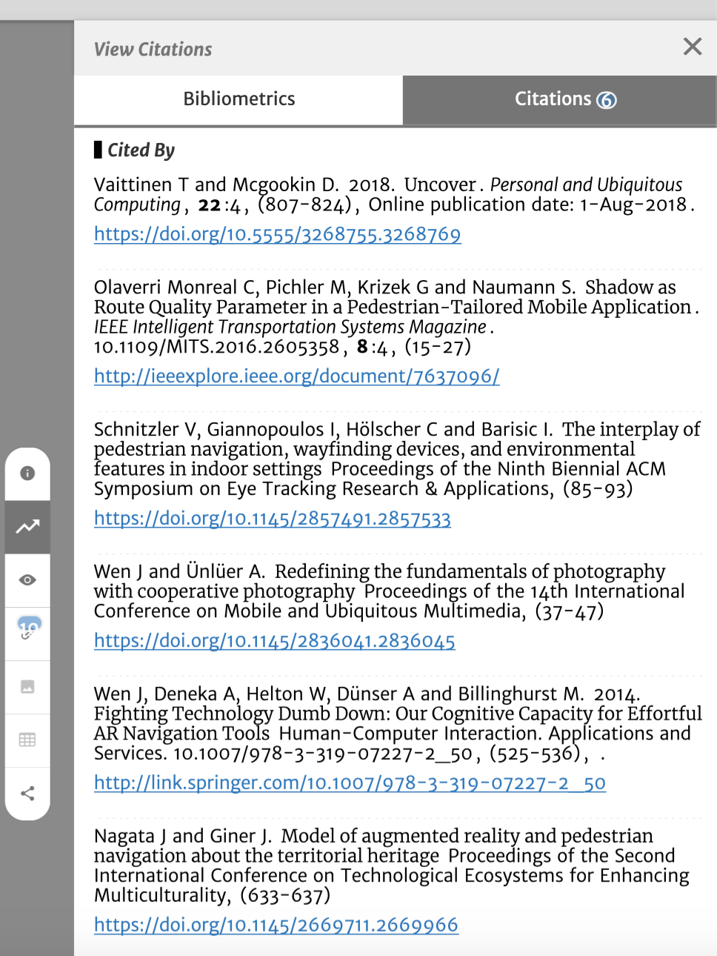
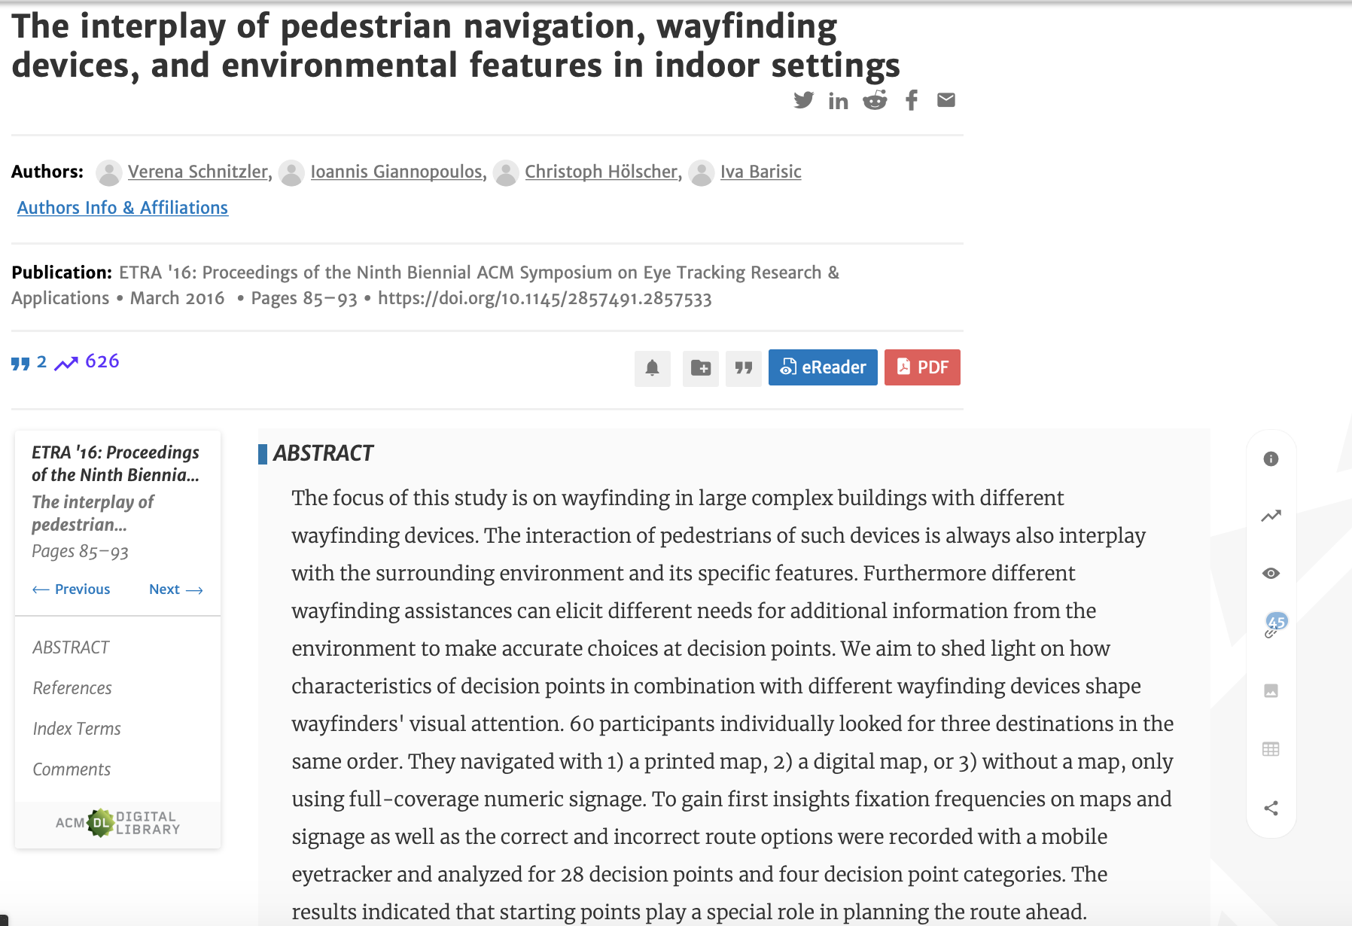
In this list, this paper looks interesting and so does the abstract. It would at least be worth a read to see how relevant.

Slide 30
Other hints
If you are finding that the papers that are being returned are outdated (e.g., the technology not necessarily the results or relevance though), you can change the search result lists to show the latest publications first instead of relevancy.

Slide 31
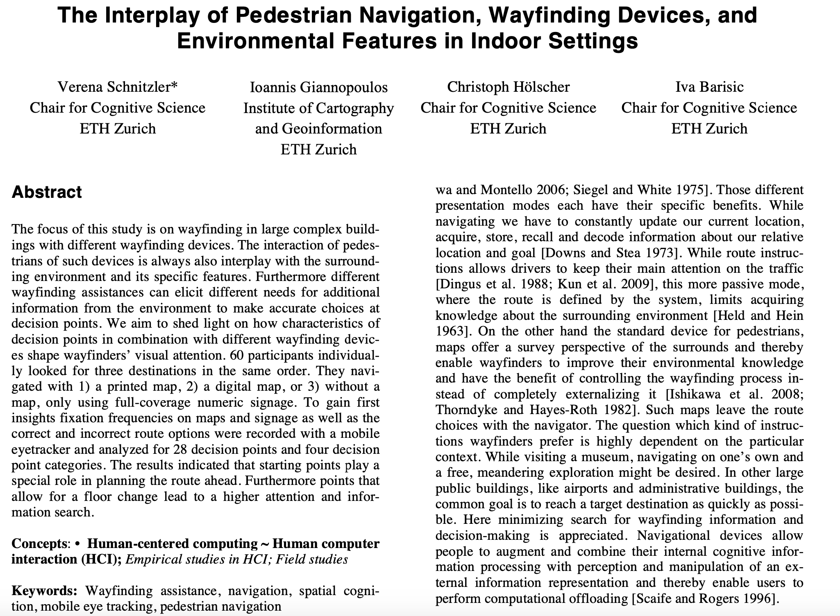
Other hints
To help you find more recent terms, look at recent papers and see the terminology that they use and keywords.
In this paper, they use other terms that what we were using: wayfinding, pedestrian navigation

Slide 32
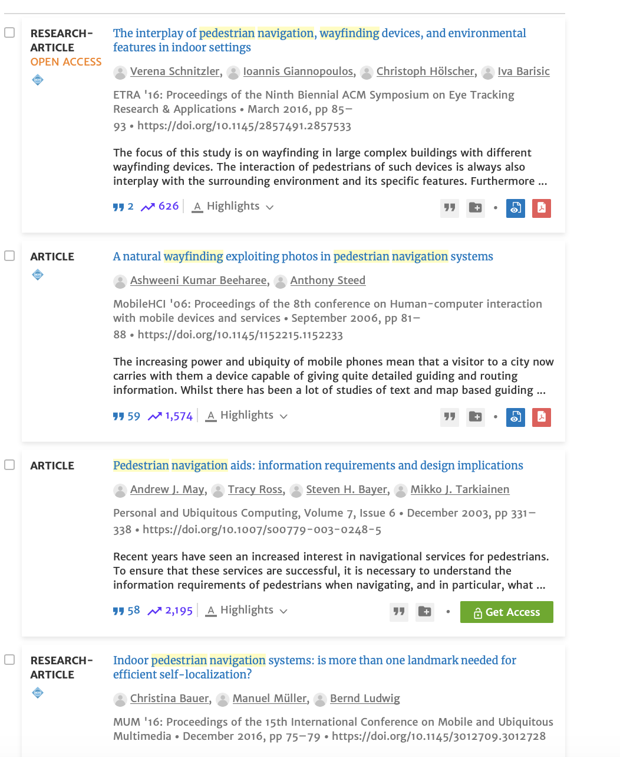
Other hints
New Search:
wayfinding pedestrian navigation maps

Slide 33
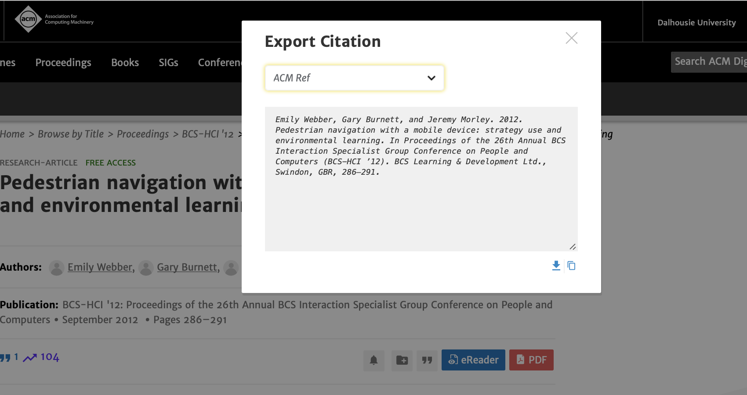
Make sure to properly cite your work
In the ACM library, you can get the reference in ACM format right on the page. Use it!
Click the double quotes on the main page.
Then in the dropdown box of the popup window select ACM Ref. Copy and paste right into your references.
Double quotes

